Slide 1

Adverse Drug Reaction Reporting Events
Presented by: Rebecca Lorig & Jamie Boyer, 10 Oct 2021
LaunchCode CoderGirl Data Science Track (Sept Cohort)

Slide 2

Benzodiazepine Analysis
Pharmacological Class of medication
Xanax, Klonopin, Ativan, Valium
Treats panic/anxiety disorders, epilepsy
Is there a seasonal pattern to adverse reports of the medication?
I’d expect higher counts in the winter due to seasonal depression and higher issuance of the drugs

Slide 3
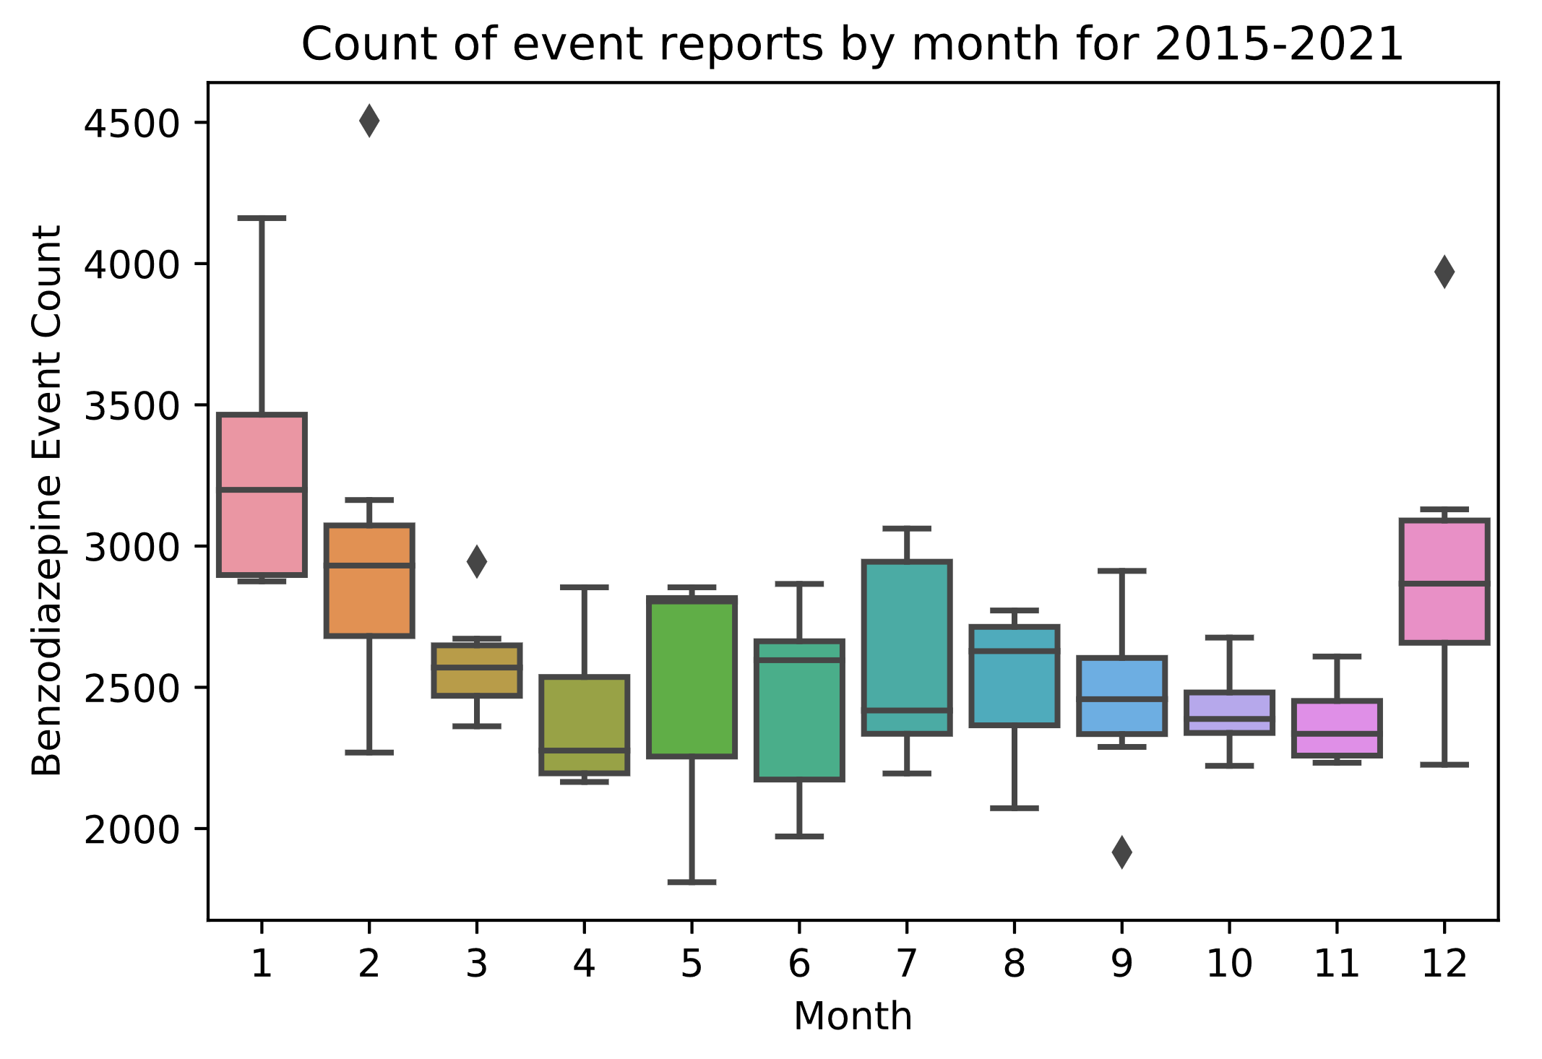
Benzodiazepine Reports by Month
Drug class = benzodiazepine
Gender
Age
Reporting date
Total = 136,000 records
Yearly comparison – how they differ among years

Slide 4
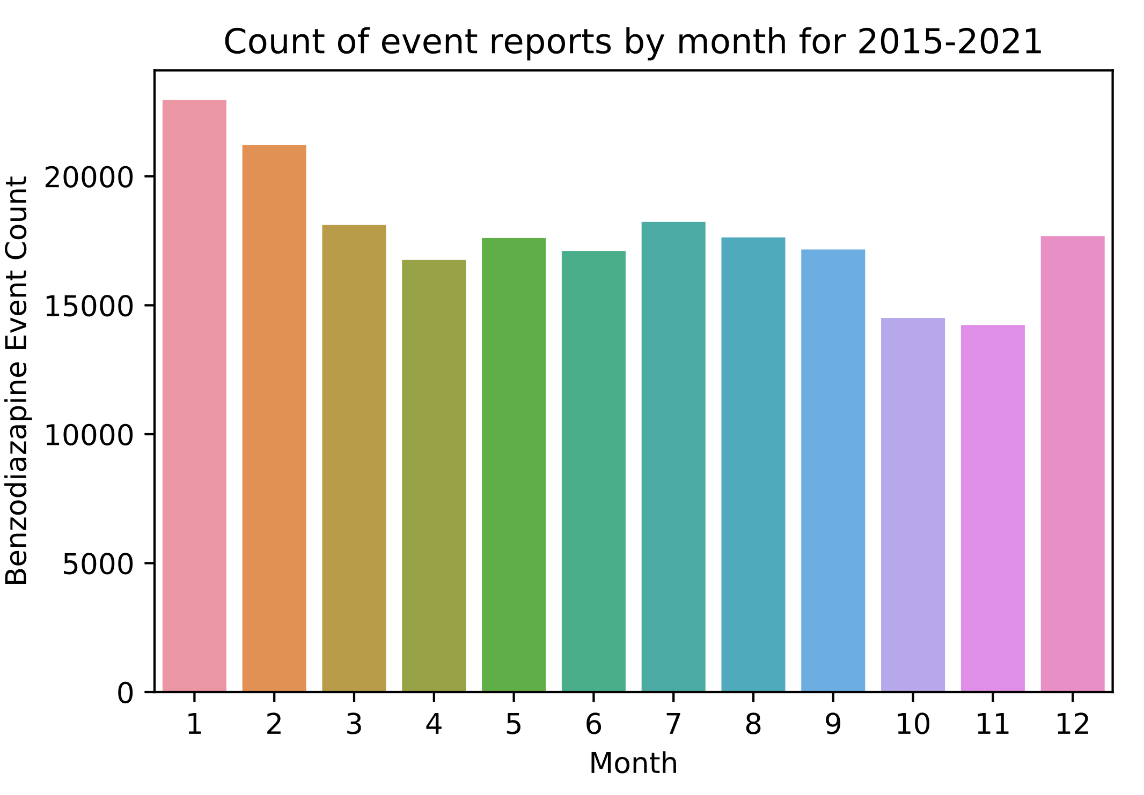
Benzodiazepine Reports by Month
Drug class = benzodiazepine
Reporting date
1-way ANOVA (analysis of variance)
Pair-wise Post-Hoc Tukey

Slide 5
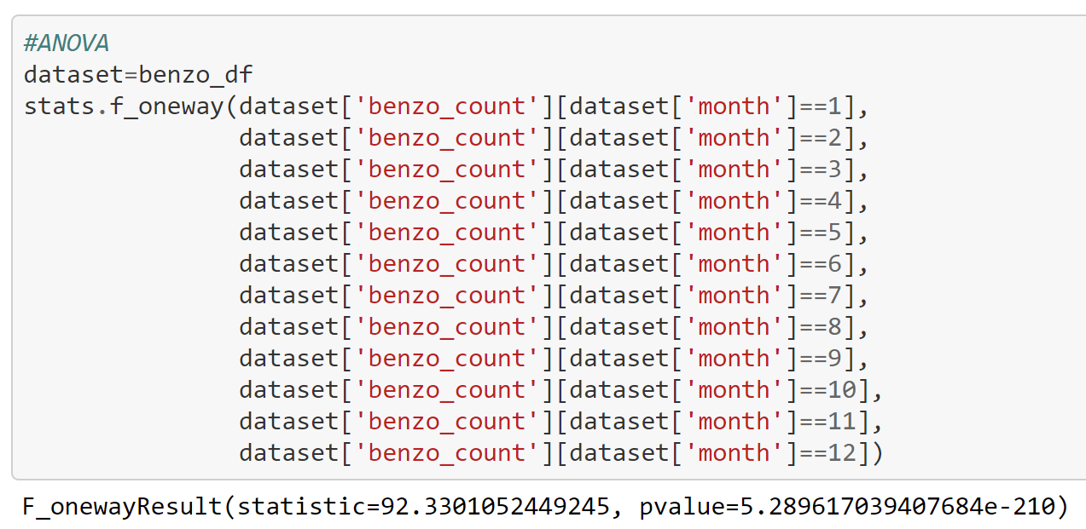
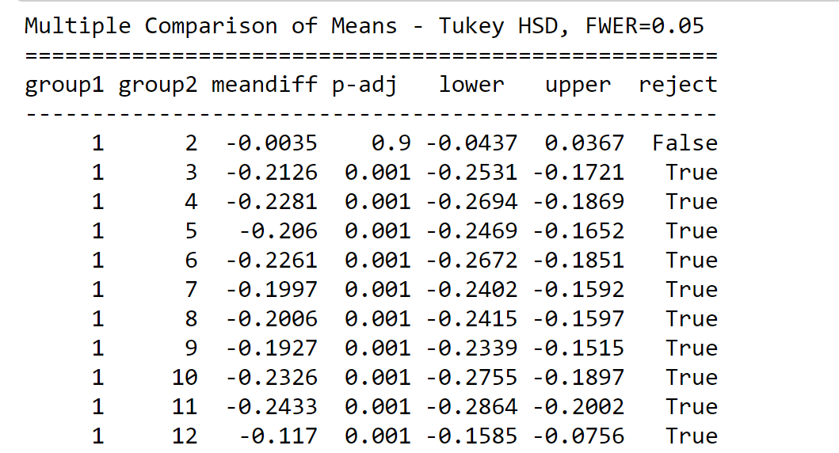
Benzodiazepine Reports by Month
Drug class = benzodiazepine
Reporting date
1-way ANOVA (analysis of variance)
Pair-wise Post-Hoc Tukey
Statistically significant Months:
Dec, Jan, Feb!
Seasonal increase in Benzodiazepine drug
adverse effects reported!

Slide 6
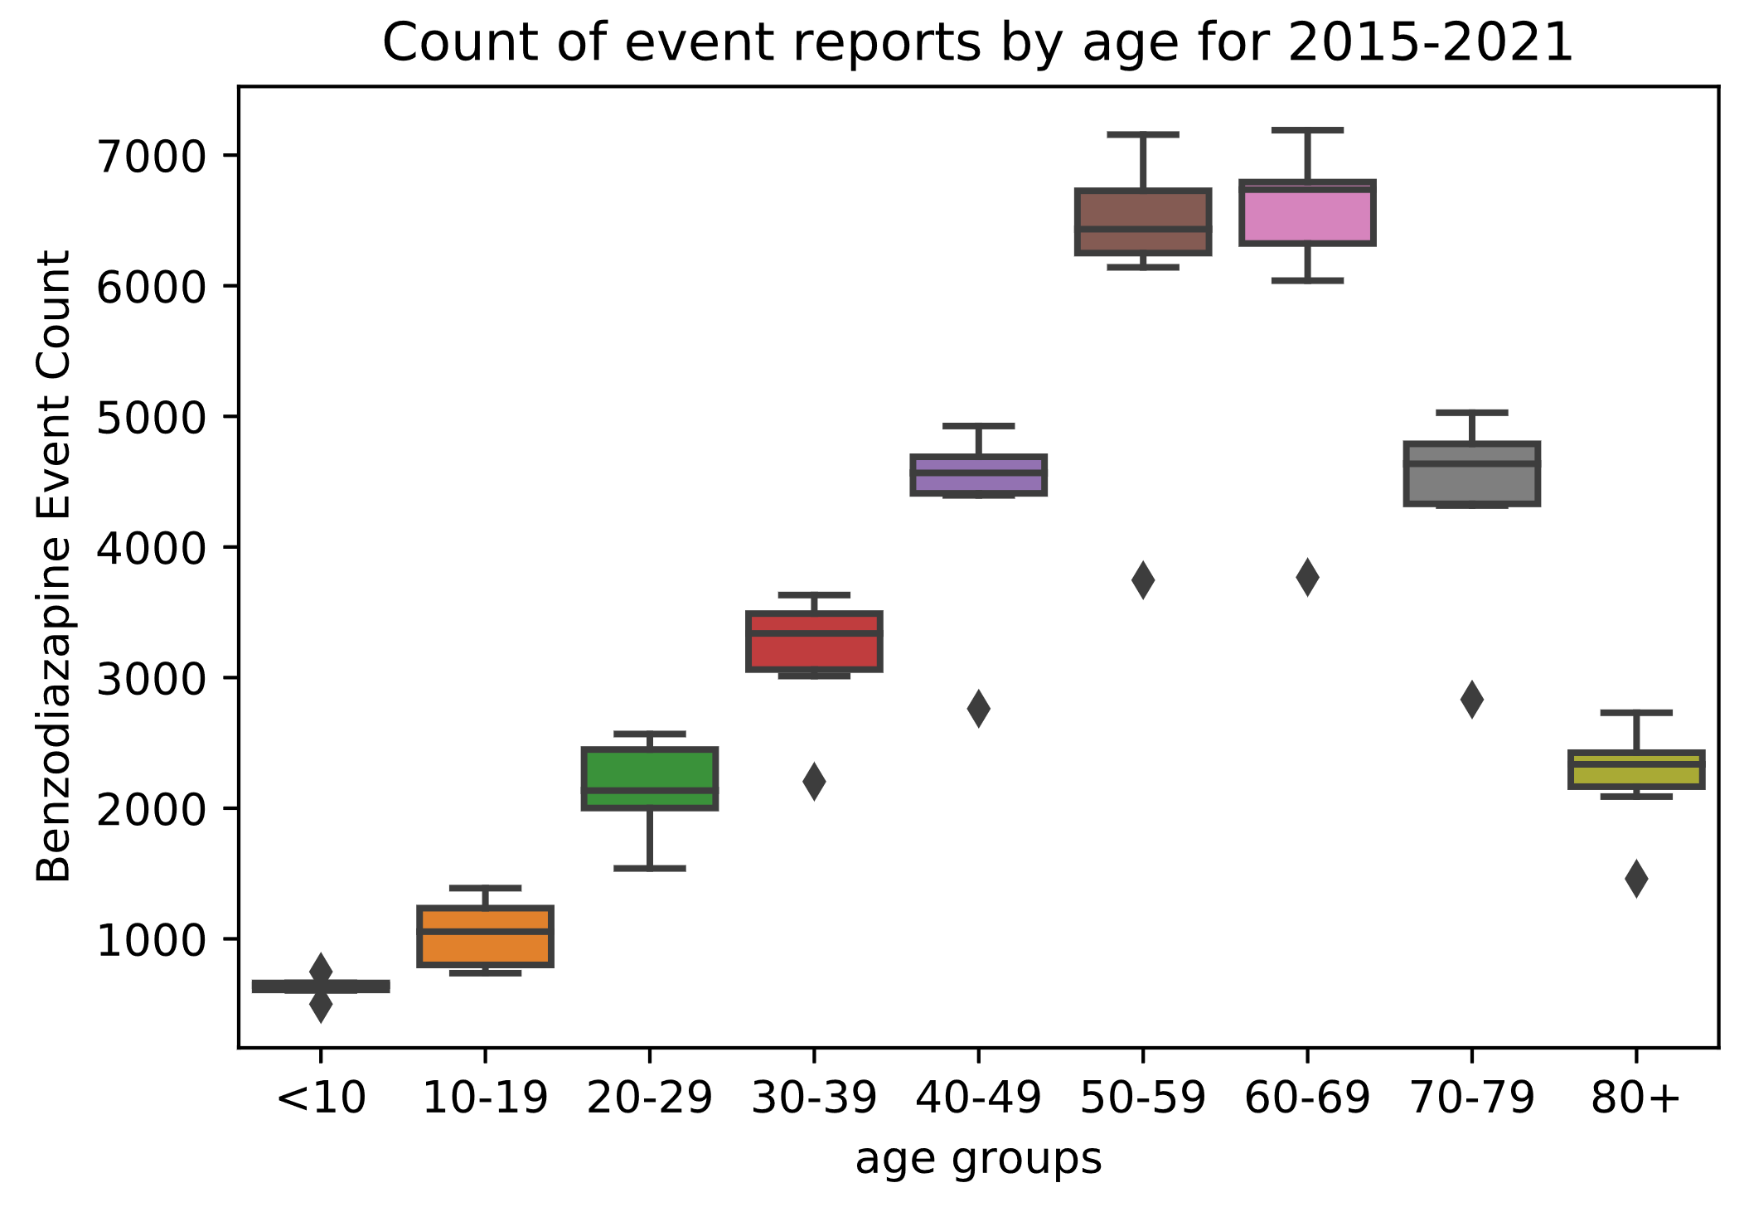
Benzodiazepine Reports by Month
Drug class = benzodiazepine
Reporting date
Age bins
1-way ANOVA (analysis of variance)
Pair-wise Post-Hoc Tukey
50-59 and 60-69 bins are statistically significantly higher than all other age groups
Same months (Dec, Jan, Feb)
50-59 & 60-69 higher event count,
Seasonal increase in Benzodiazepine
adverse effects reported for these ages!

